Slide 1

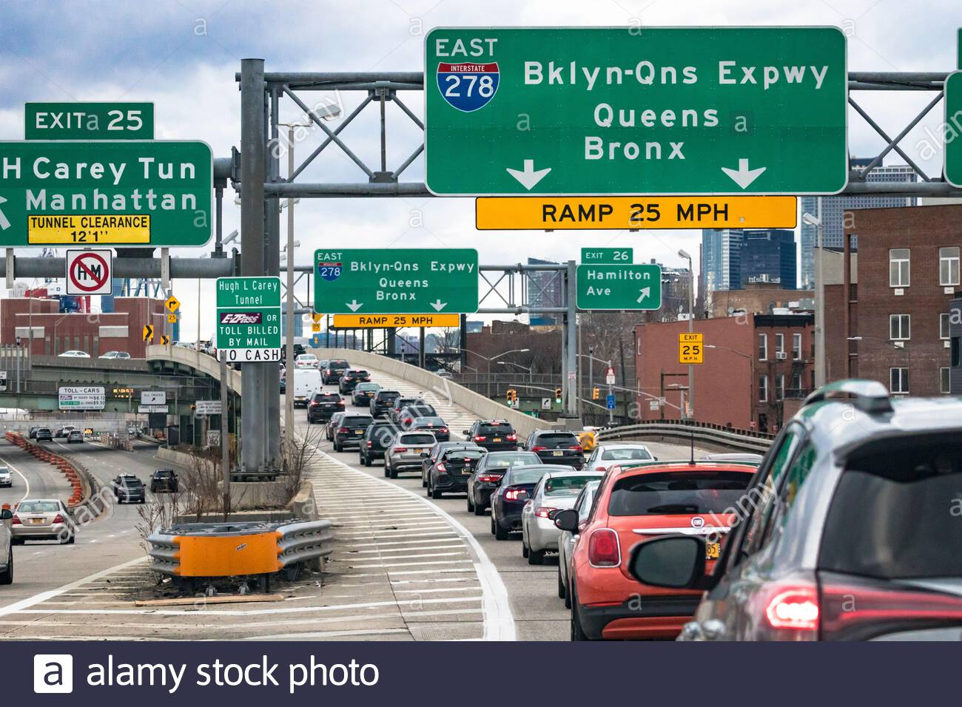
Opening a Turkish Restaurant in New York
Coursera Capstone
IBM Applied Data Science
Rafael Xidane
February 2021

Slide 2


Business Problem
This capstone assignment uses Data Science tools such as Data Analysis and data Visualization to provide an insight into the following 2 business questions
As a restaurateur, what is the best location in New York to open a Turkish restaurant?
As an investor, what is a suitable location in New York to invest in a Turkish restaurant?

Slide 3



Data
Data Source
Open source dataset of New York: https://cocl.us/new_york_dataset
Geocoder package for latitude and longitude coordinates
Foursquare API for venue data
Data Processed
List of boroughs and neighborhoods in New York
Latitude and longitude coordinates of those neighborhoods
Venue data, particularly data related to restaurants

Slide 4






Methodology
Collect the data from https://cocl.us/new_york_dataset
Scrape, Scrub and load data into Pandas Dataframe
Use FourSquare API to locate all venues and then filter by Turkish restaurants
Ratings, tips, and likes by users will be counted and added to the dataframe
Sort the data based on rankings
• Visually assess the data be will be using graphing from
Python libraries.

Slide 5
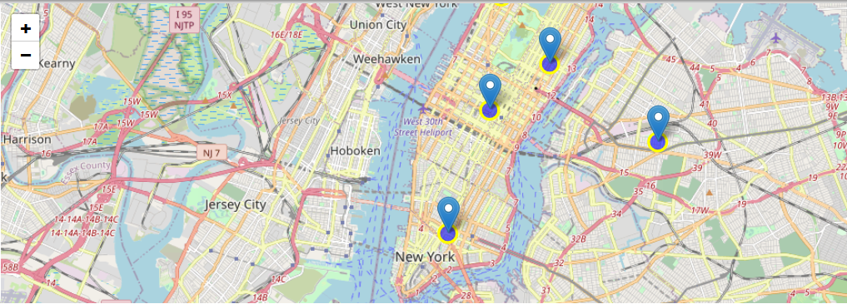
Results
• Manhattan has the highest number of Turkish restaurants comparing to the other boroughs.
• Manhattan has the highest average rating for Turkish Restaurants.

Slide 6
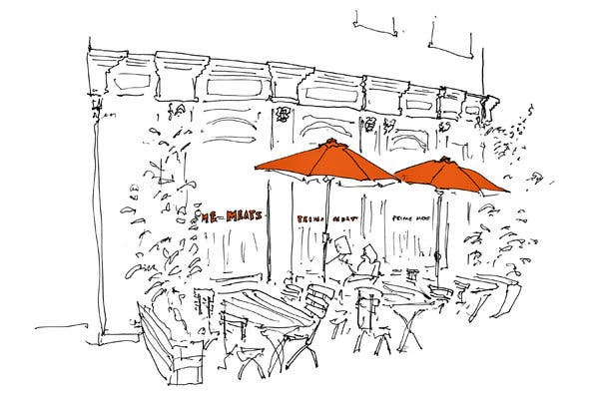


Discussion
As we can clearly see that Boroughs of Brooklyn and Bronx are perfect locations to open a Turkish restaurant. This analysis is based on the accuracy of Four Square data of course.
Even though Boroughs on Manhattan and Queens have Turkish restaurants, there still aren't enough, and with the high rating and likes it is only justified that we see more Turkish restaurants in those boroughs as well.
I will debate that real-estate rents in Manhattan in the post pandemic era will be competitive and not as exorbitant as it used to be prior to 2020. Most people now telecommute and if anything, the commercial rent in residential areas such as Bronx, Queen, and Brooklyn would see a spike as opposed to Manhattan which is mainly office buildings.
With a significant amount of immigrants from Turkey and other countries surrounding the Mediterranean, New York has relatively small number of Turkish restaurants, we definitely need to see that number rise.

Slide 7


Conclusion
The total number of Turkish Restaurants in all of New York (including all boroughs) is just 11.
Hopefully, the conclusion of my analysis will help the restaurateurs and/or investors better understand the advantages and disadvantages of different New York neighborhoods/boroughs when it comes to opening a Turkish restaurant

Slide 8

The End

